Slide 1



Windows Administration
Telerik Software Academy
academy.telerik.com
Installing Windows Client and Server
Borislav Varadinov
System Administrator
bobi@itp.bg

Slide 2

Table of Contents
What is a Server?
Server or Client OS?
Windows OS History
Hardware and Requirements
Licensing
Server Core
Disk and Partition Management
Services
Drivers

Slide 3

What is a Server?
A server is a computer that provides shared resources and serves client requests.
Database Server
File Server
Web Server

Slide 4
Server or Client OS?
Client OS
A client operating system is generally a single user OS
It is designed for workstations or portable devices
Server OS
A server operating system is a multi-user operating system
it is optimized for multiple user access at the same time and sharing all of the resources
Notes:
A client operating system is generally a single user operating system where only one user can be actively using the computer at any one time.
It is designed for desktops coputer or portable devices.
A server operating system is a multi-user operating system where it is optimized for multiple user access at the same time sharing all of the resources.

Slide 5
Windows OS History
Domestic Use
MS-DOS
Windows 1
Server
Corporate Use
Windows 2
Windows 3
NT Server 3
Windows 3.1 and 3.11
Windows NT 3
NT Server 4
Windows NT 4
Windows 95
Windows 98
Windows ME
Server 2000
Windows 2000
Server 2003 (+R2)
Windows XP
Windows XP Home
Server 2008
Windows Vista
Windows Vista Home
Server 2008 R2
Windows 7
Windows 7 Home
Server 2012
Windows 8
Windows 8 Home

Slide 6
System Requirements
Minimum requirements for Windows Server 2008 R2
1.4 GHz 64bit processor
512 MB RAM
10 GB Disk Space
Super VGA (800 x 600) or higher-resolution monitor
Keyboard, mouse

Slide 7


Server Hardware
Physical Machine
Virtual Machine

Slide 8
Licensing and Editions
Windows Server 2008 R2
Web Edition
Itanium Edition
Standard Edition
Enterprise Edition
Datacenter Edition
For detailed information download:
http://download.microsoft.com/download/F/C/6/FC6006B5-866E-42C1-88F8-9AC4B8BC610D/WS%20Brand%20Pages%20-%20Editions%20Comparison%20Guide.pdf

Slide 9
Install from Removable Media
Media installation is the common way to install Windows Server or Client versions
CD
USB
Install windows from media (Demonstration)
Create Virtual Machine
Boot from virtual media
Select/Format Partition
Select Edition and Installation Option
Install Windows Server OS
Notes:
http://www.microsoft.com/en-us/download/details.aspx?id=11093

Slide 10
What is Server Core?
Server Core is a special installation option of Windows Server OS with minimal GUI
It was introduces for first time in Windows Server 2008
In Windows Server 2012, Server Core became a feature that can be added or removed without completely reinstalling the operating system
In Windows Server 2012, Microsoft also introduced a new configuration option called Minimal Server Interface.
Where is the core version of the client OS?

Slide 11
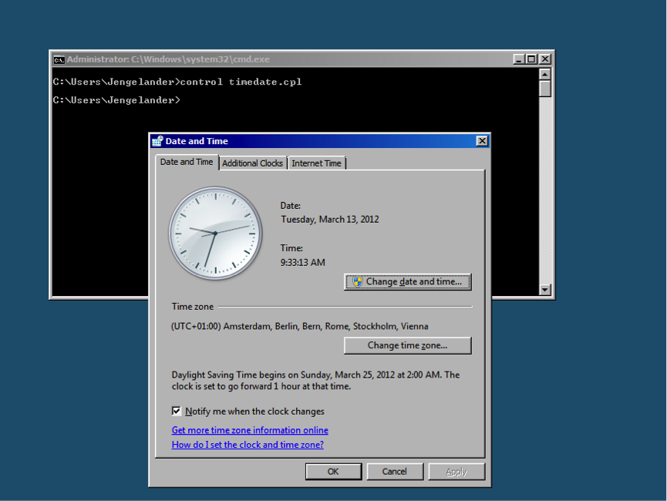
Benefits of using Server Core
Reduce system resource overhead
Reduce attack surface
Reduce requirements for support and management

Slide 12
Initial Configuration Tasks Wizard
Activate Windows
Set time zone
Configure computer name and networking
Update windows
Enable Remote Desktop
Allows administrator users on the network to connect to and manage the server remotely
Configure Windows Firewall

Slide 13
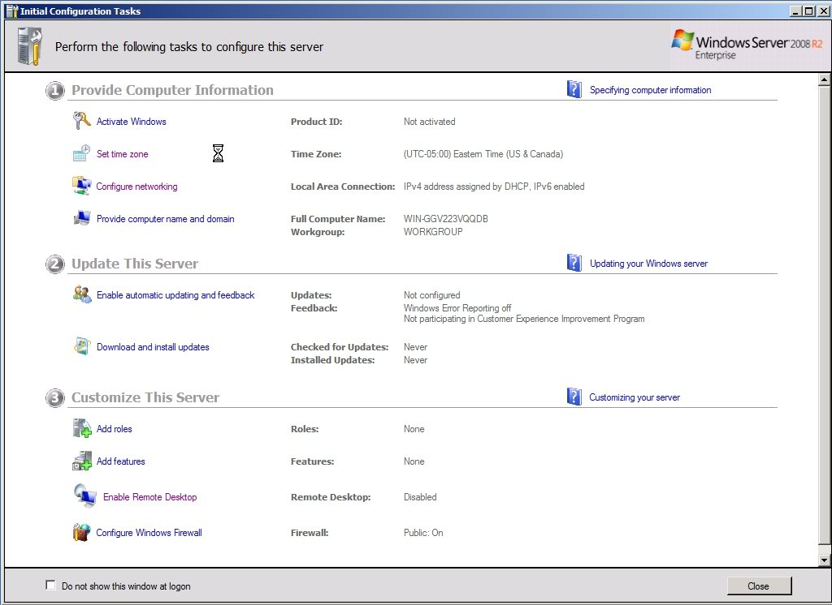
Initial Configuration Tasks Wizard

Slide 14
Disk and Partition Management
Disk Management
Create Partitions
Format Partitions
Disk Management Command Line Utility (Diskpart.exe)
For detailed explanation of Windows Drive Partitioning, Basic disks and Dynamic disks, please refer to the OS Course.

Slide 15
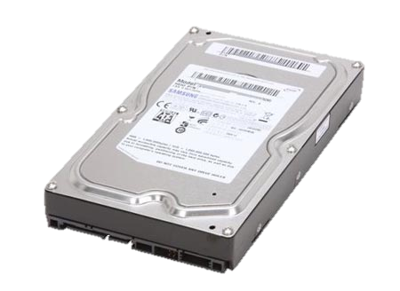
What is a Virtual Hard Disk?
VHD/VHDX
VHD and VHDX are a file format which represents a virtual hard disk drive
Three types of VHD disks:
Fixed disks
Dynamically expanding disks
Differencing disks
Notes:
Fixed disks
Larger (slower to deploy)
Recommended for production systems
Dynamically expanding disks
Grow as data is added
Smaller (faster to deploy)

Slide 16
Working with VHD/VHDX
Create
Attach
Install Windows on VHD
Notes:
create vdisk file=”D:\Win2008.vhd” type=expandable maximum=maxsizeInMegabyte
select vdisk file=”D:\Win2008”
attach vdisk

Slide 17
What is a Service?
A Service is a long running computer program that operates in the background
Provides specific function that is designed to require no user intervention
Similar in concept to a Unix daemon
Can be configured to start when the operating system is started
Example of services:
Task Scheduler / FTP Publishing Service
My custom WEB Server

Slide 18
Service startup types
Automatic
Automatic (Delayed)
Introduced in Windows 2008
Manual
Disable

Slide 19
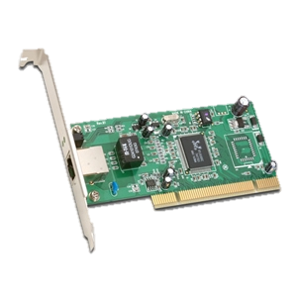
What is a Driver?
Device
A device is a unit of hardware that performs a special function and is attached to a computer.
Device Driver
A device driver is a small software program that operates or controls a particular type of device that is attached to a computer.

Slide 20
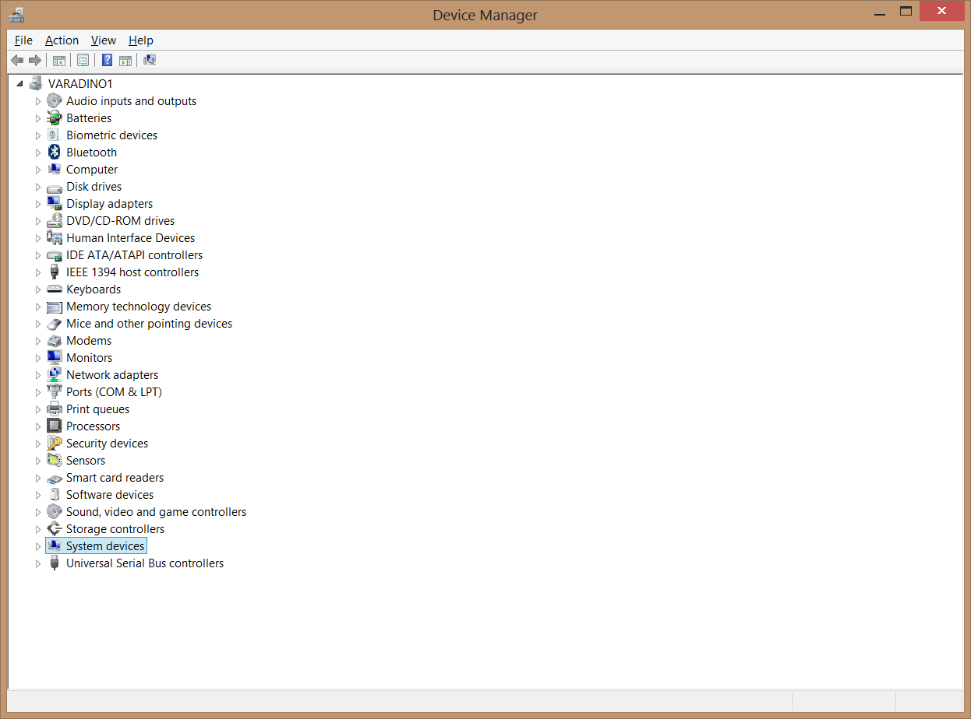
Device Manager

Slide 21
How does Windows OS know which driver to use?
Device identification string
The computer devices have a set of registers that identify the vendor and the device model
Windows OS uses these IDs to identify the attached devices and to select the suitable drivers for them
Example of device identification string:
PCI\VEN_10E8&DEV_4750

Slide 22

How does Windows OS know which driver to use? (cont.)
INF files
INF file contains instructions for installing the drive and software for a particular device
Yellow question mark?
Windows cannot find a valid driver for this device

Slide 23
Installing Drivers
Download drivers from a vendor web site
Choose the correct OS version
Select x64 or x86
Select Driver Version
Read device specification
Download drivers by Windows Update
Roll Back Driver
The drive roll back process uninstalls the current driver and then reinstall the previous one automatically

Slide 24
What is a Drive Signing?
A signed driver is a device driver that includes a digital signature.
A digital signature is an electronic security mark
indicate the publisher of the software
Indicate whether someone has changed the original contents of the driver package.

Slide 25
Why we need driver signing?
User
Space
Applications
Windows API
Kernel
Space
NT Kernel
Kernel Mode Drivers
Hardware Abstraction Layer
Hardware

Slide 26
Driver Signing Policy
For 64-bit versions of Windows Vista and later versions of Windows (client and server), driver code signing policy requires that all driver code have a digital signature.

Slide 27
Installing and Configuring Windows OS
http://academy.telerik.com

Slide 28




Free Trainings @ Telerik Academy
"Web Design with HTML 5, CSS 3 and JavaScript" course @ Telerik Academy
html5course.telerik.com
Telerik Software Academy
academy.telerik.com
Telerik Academy @ Facebook
facebook.com/TelerikAcademy
Telerik Software Academy Forums
forums.academy.telerik.com

Slide 29

Servers

